Slide 1


MERCURIAL
Presented by:
Nandini Srivastava
500105220
R2142220576

Slide 2
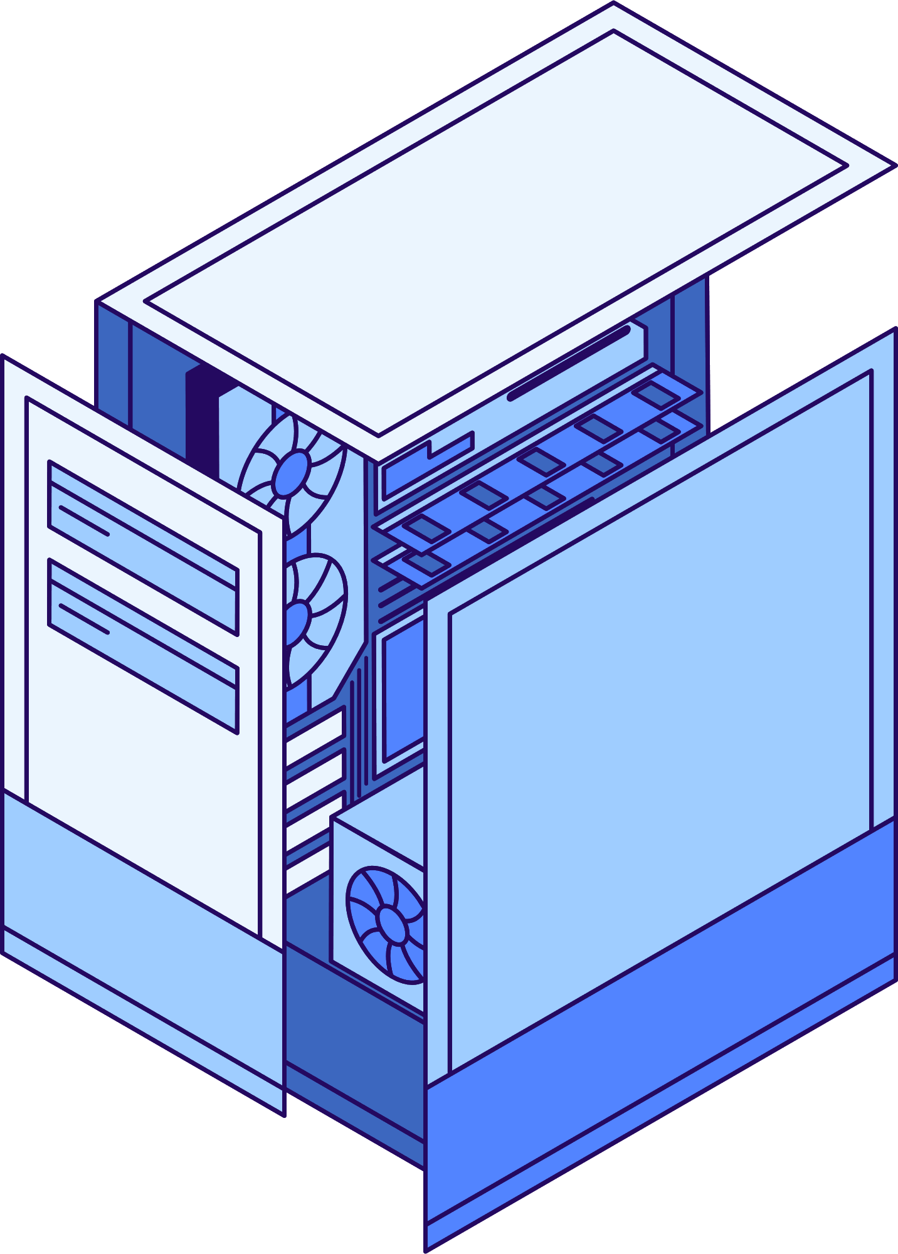
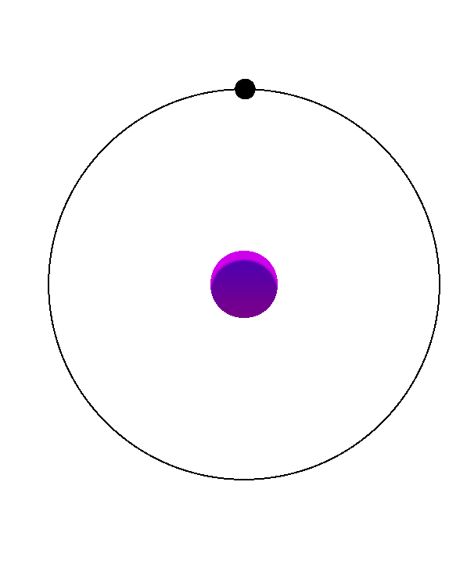
DEFINITION
Mercurial is a distributed version control system (DVCS) that enables efficient handling of projects of any size. It offers a simple and intuitive interface for tracking changes, collaborating with team members, and managing project history.

Slide 3
INTRODUCTION TO MERCURIAL
Mercurial is a distributed version control system designed for speed and efficiency.
It allows multiple developers to work on a project simultaneously without a central server.
KEY FEATURES INCLUDE:
Distributed Version Control: Every developer has a full copy of the repository, enabling offline work and independent branching.
Lightweight and Fast: Efficient handling of large projects and binary files.
Simple and Intuitive Commands: Commands are easy to learn and use, with a consistent syntax.
Cross-Platform: Works on Windows, macOS, and Linux.
Extensible: Supports plugins for additional functionality.
Secure: Uses SHA-1 hashing for data integrity and supports signed commits.

Slide 4
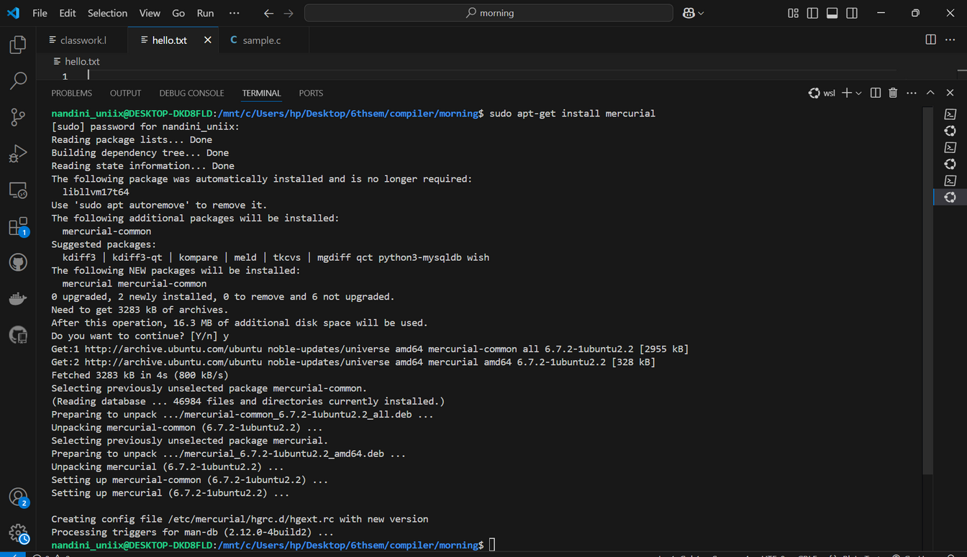
INSTALLATION
LINUX: wsl command:
sudo apt-get install mercurial

Slide 5
Workflow Example
Initialize a Repository:
hg init my_project
cd my_project
2. Add Files:
echo "Hello, Mercurial!" > file.txt
hg add file.txt

Slide 6
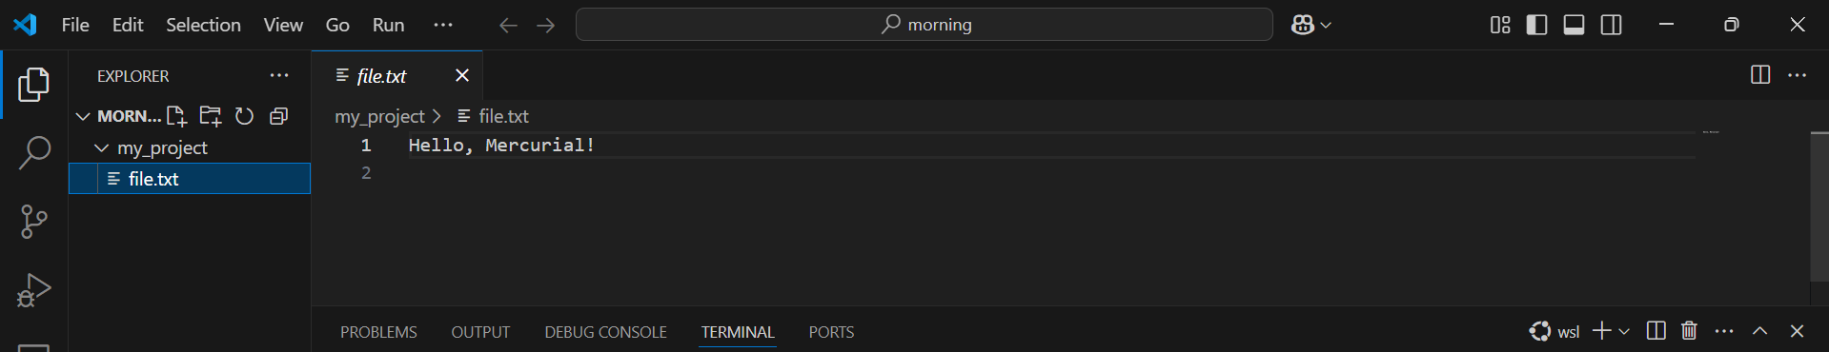
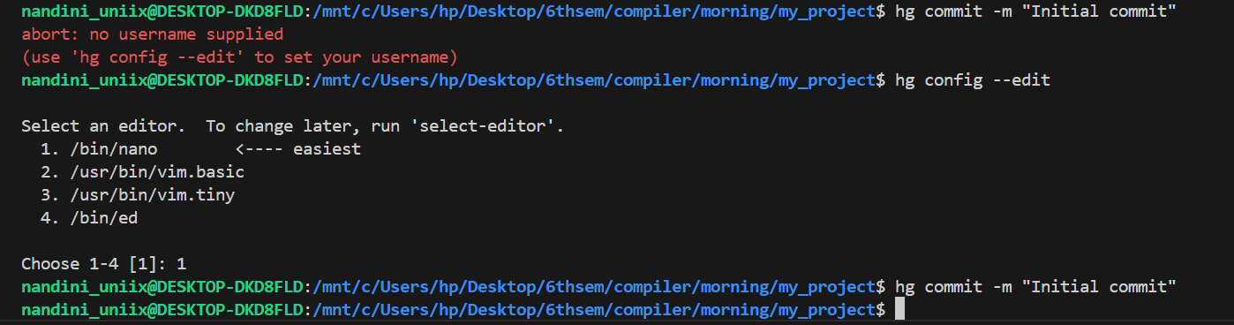
3. Commit changes
hg commit -m "Initial commit"
Since the username has to be editied, use the nano command nd add the username

Slide 7
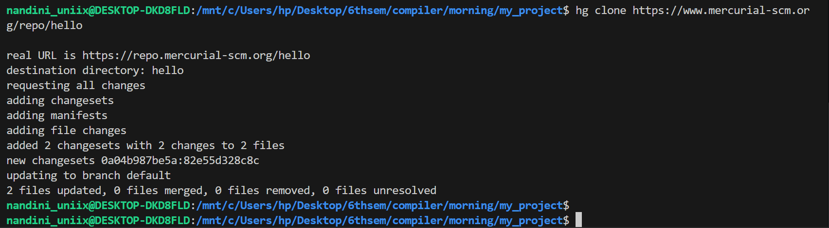
4. Clone a Remote Repository:
hg clone https://www.mercurial-scm.org/repo/hello
5. Push changes to Remote
hg push

Slide 8
ADVANTAGES
Ease of Use: Simpler and more consistent commands compared to Git.
Performance: Handles large repositories efficiently.
Flexibility: Supports both centralized and distributed workflows.
Extensibility: Plugins allow customization for specific needs.
DISADVANTAGES
Less Popular: Git has a larger community and ecosystem.
Fewer Hosting Options: Platforms like GitHub and GitLab are more Git-focused.

